Slide 1
Living in the Ukraine
Comparing the Ukraine and Canada (similarities and differences)

Slide 2
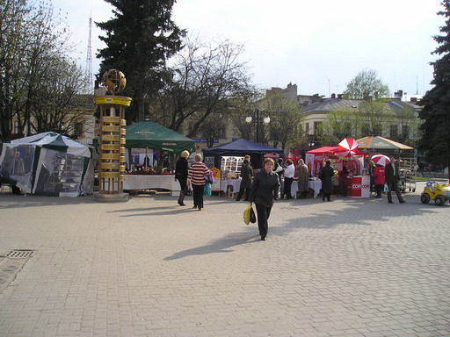
Ivano-Frankivsk is the main city in the Carpate Mountain region in Eastern Ukraine.

Slide 3
Street vendors selling paska bread.

Slide 4
This paska bread is fresh from the oven.

Slide 5
Olga Pantelyuk prepared the dough, decorated and baked all of these paska delights.

Slide 6
These Easter eggs were painted by hand.

Slide 7
This priest is blessing these Easter baskets.

Slide 8
These people are waiting for the priest to bless their Easter basket. These baskets are covered with traditional cloths that have been cross-stitched.

Slide 9
A collection of dolls that have been dressed in traditional costumes. Each costume represents a different region of the Ukraine.

Slide 10
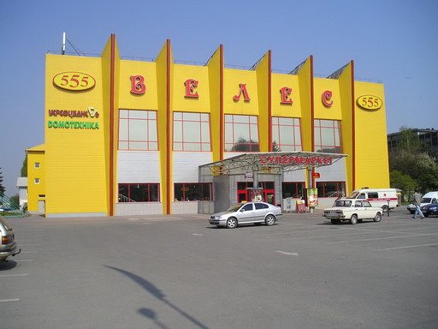
The exterior of two grocery stores.

Slide 11
The inside of a grocery store.

Slide 12
Some chocolats and products in a bakery.

Slide 13
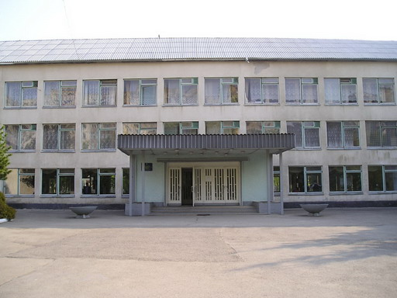
The exterior of a school (himnaziya) : certains subjects are taught in German.
The entrance to a school.

Slide 14
A park located just outside of a school.

Slide 15
A decorated wall in the entrance of a school.

Slide 16
A cafeteria in a school.

Slide 17
The gymnasium of a school.

Slide 18
There are many libraries in this city. Certain libraries are reserved for children, like this one, while others are uniquely for adults. There are also libraries that have books for all ages.

Slide 19
The main square in the city of Ivano-Frankivsk.

Slide 20
A bank in the city of Ivano-Frankivsk.

Slide 21
An old tower in the city ofIvano-Frankivsk built in 1870.

Slide 22
A modern musical fountain : the volume of the music determines how high the water will jump.

Slide 23
A Greek Catholic cathedral built in 1774.

Slide 24
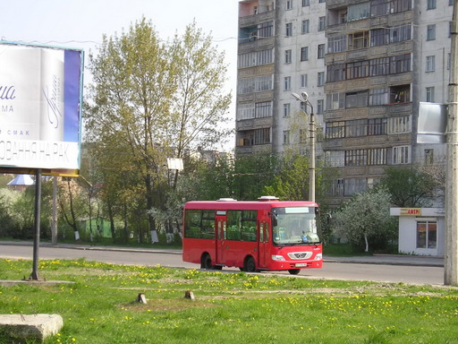
An electric bus.
A city bus.

Slide 25
The ambulance services in cities in the Ukraine is reliable and efficient .

Slide 26
In the largest cities, it is the responsibility of the public garbage service to ensure that the streets are clean.

Slide 27
A « kobzary », one of the traditional story tellers who sings of the stories of the Cosaques. The traditional « kobzarys » are the keepers of Ukrainian folklore and are hard to find today.

Slide 28
The Pysanka Museum in the city of Kolomiya.

Slide 29
Verchovina is a small village in the heart of the Carpate mountains.

Slide 30
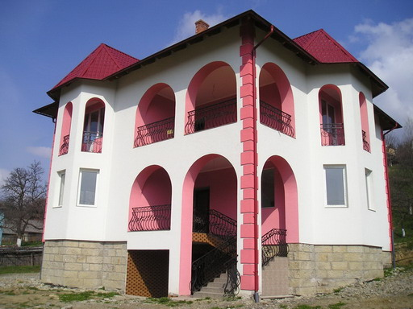
A modern log cabin.
A modern hotel under construction.

Slide 31
The Carpate Mountains are covered in snow.

Slide 32
A city with an old castle dating from the XIV and XVIII centuries.

Slide 33
An old fort in Khotyn.

Slide 34
In Kiev, this ukrainian orthodox church, Andriyivska (église Saint -André) was built in 1754 by an Italian architect. The church was built following a traditional style: in the shape of a cross with five domes.

Slide 35
These large residential complexes are built on the outskirts of cities. There is a large demand for lodging in the cities.

Slide 36
The modern monastary of Saint-Michel. In 1936, the Russians destroyed the original monastary (dating from 1108). The reconstruction allowed the doors to be reopened in 2001.

Slide 37
This woman is kissing this bell as a sign of respect for the saints whose names are inscribed on the bell. The bell is located in front of the Pechersk Lavra monastary.

Slide 38
In the city parks, men gather to play chess; one of the most played games in the country.

Slide 39
A residential zone in the downtown core of the city is filled with appartement complexes of three or four stories. There are often small parks behind these complexes, allowing young children to have a place to play.

Slide 40
This new underground mall was built close to the subway, under the main square in Kiev.

Slide 41
The Ivan Franco opera house in the city of Lvov.

Slide 42
Independance Place in Kiev : this was the sight of the « Orange Revolution ».

Slide 43
The subway is the mode of transportation of the « priviledged ». There are three metro lines in Kiev.

Slide 44
These vegetables are beautifully displayed in this market built in 1910 located in Bessarabia.

Slide 45
These women have kept certain traditional folklore alive by dressing in costumes worn years ago by people of southern Ukraine .

Slide 46
The Arch of Friendship, a symbol of the union of Russia and the Ukraine built in 1654.

Slide 47
The Dynamo stadium in Kiev welcomes the famous soccer team, DynamoÂ Kyiv. Soccer is a very popular team sport and the games draw big crowds.

Slide 48
At the edge of the Black Sea, there are many bays that house ports and beautiful beaches.

Slide 49
This is the castle of the hummingbird’s nest, built on the Black Sea, to the west of Yalta. It was built in 1912. The castle was almost completely destroyed by an earthquake in 1927, but it was rebuilt in 1970.

Slide 50
In the summer, the beaches of Crimée attracts thousands of Ukrainians and Russians.

Slide 51
The Dnipre river divides the city of Kiev. It is the largest river in the Ukraine. It flows into the Black Sea.

Slide 52
Ukrainian villagers often maintain a traditional style of life. They can often be seen using a good old-fashioned horse and plow.

Slide 53
Windmills, although they are no longer used, represent the long history of the Ukraine. Horse and buggy are also an element of the past, but are still used in some rural agricultural regions.

